Slide 1
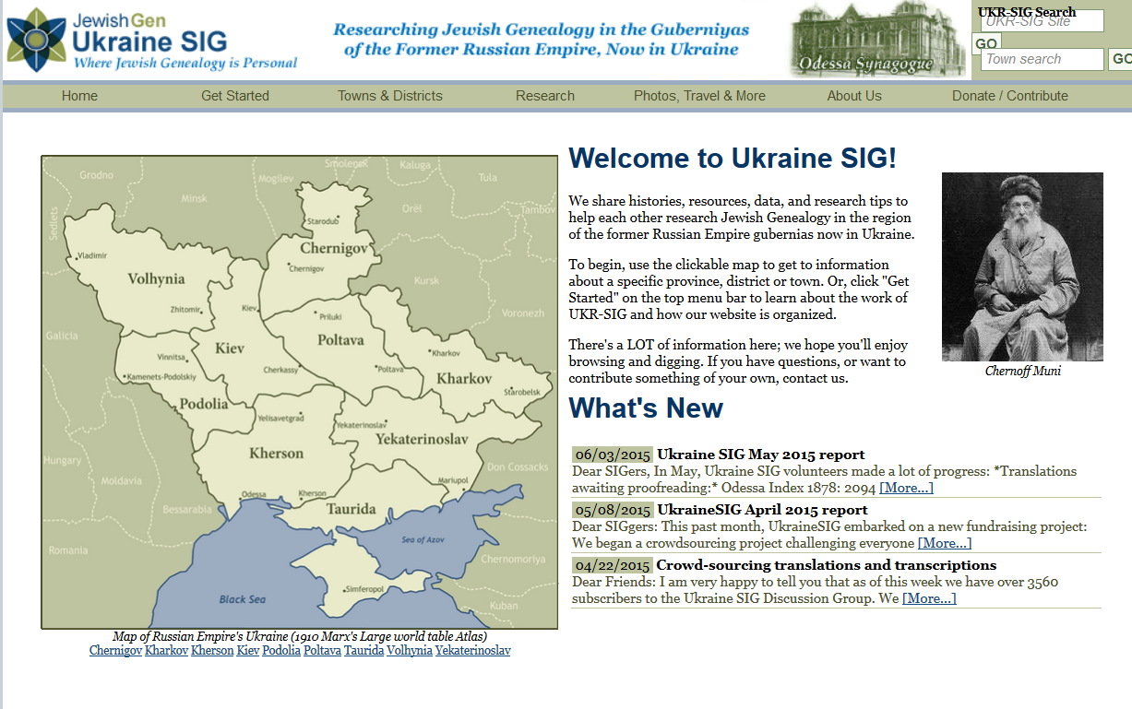

Slide 2
UKRAINESIG 2014-2015
Dr. Janette Silverman, Ukraine SIG Coordinator
Ukrainesig.coordinator@gmail.com http://www.jewishgen.org/Ukraine/default.asp

Slide 3
TOWN | RECORD TYPE | YEAR(S) | SOURCE | # OF RECORDS
 |  |  |  | Birth | Marriage/Divorce | Death
Priluki / Pryluky / {-1051731}/ פּרילוקי / Прилуки | Births | 1855-1859, 1861, 1863-1868, 1871-1873 | FHL SACU | 1822
 | Deaths | 1856-1859, 1862-863, 1865-1866, 1868-1869 | FHL SACU |  |  | 700
Zaslavl / Izyaslav / {-1040503} / זאַסלעוו / Изяслав | Births | 1845-1851 | ZaSAVO | 1106
 | Deaths | 1848-1851, 1853-1865, 1867-1881 | ZaSAVO |  |  | 6353
Mogilev-Podolskiy / Mohyliv-Podil's'kyy / {-1046905} / מאָלעװ / מאָהילעװ/ Могилёв-Подольский | Births | 1844 | CAHJP | 286
 | Deaths | 1844 | CHJP |  |  | 160
Nikolayev /Mikolayiv/ {-1047644} / מיקאָלײַעווע / Николаев | Births | 1878, 1889-1895 | FHC NKKR | 4311
 | Deaths | 1876, 1877 | FHC NKKR |  |  | 373

Slide 4
Smiela / Smila / {-1054390} / Смела | Births | 1840, 1846 | SACO | 294
 | Deaths | 1846 |  |  |  | 113
Belaya Tserkov / Belaya Tserkov /{-1035624}/ שוואַרץ־טומאה / Белая Церковь | Births | 1850 | FHC TsDIAU | 138
 | Deaths
Ignatovka / Hnativka / {- } / אנטבקה / Игнатовка | Births | 1854 | FHC TsDIAU | 48
 | Deaths | 1854 | FHC TsDIAU |  |  | 36
Zinkov / Zinkov / {-1060918} / זינקעוו / Зиньков | Births | 1839, 1849-1850 | ZiRK | 341
 | Deaths | 1849-1850 |  |  |  | 160
Byshev / Byshev / {-1036778} / Бышев | Births
 | Deaths | 1855 | FHC TsDIAU |  |  | 24
Makarov / Makarov / { -1045481} / Макаров | Births
 | Deaths | 1854 | FHC TsDIAU |  |  | 89
Chernigov / Chernihiv / {-1037057} / Чернігів / וועיִנרעשט | Births
 | Deaths | 1881, 1906-1908, 1913-1915, 1917-1918 |  |  |  | 1,833

Slide 5
Odessa / Odesa / Оде́са / {-1049092}
 | Births | 1878-1881, 1882-1889, 1891, 1894, 1896-1897, 1900 | SAOR | 56,029

Slide 6
From the 1837 records:
• Mitava: 881 entries
• Libava: 73
• Vindava: 130
• Goldingen: 377
• Gazenpot: 588
• Grobin: 15
• Polangen: 67
• Tuckum: 33
• Pilten: 96
• Jakobshtat: 76
• Bausk: 994
• Fridrikhshtadt: 0
From the 1840 records:
• Mitava: 881 entries
• Libava: 76
• Vindava: 10
• Goldingen: 173
• Gazenpot: 616
• Grobin: 14
• Polangen: 0
• Tuckum: 11
• Pilten: 0
• Jakobshtat: 62
• Bausk: 686
• Fridrikhshtat: 10

Slide 7
June 2015 Report
Translations received awaiting proofreading
Chernigov Film 2101468: Volume 679-10/1308 Deaths 1906
Chernigov Film 2101469: Volume 679-10/1308 Deaths 1908, 1899,1913, 1914, 1915, 1917, 1918
Priluki 2423892 item 8 1860: 85 deaths
Priluki 2423892 item 9 1870: birth records 56 girls and 67boys
Odessa 1877: 1,995 births
Films scanned
Kerch: 2008421 items 1-3: 671 images
Kerch: 2041505 items 60, 61: 84 images
Simferopol: 2041506 items 15, 16, 17: 440 images
Kozelets 2392160 items 1 and 2: 120 images
Smela: 2289444 items 1-16: 710 images
Priluki: 2423899 items 9-20: 473 images
Simferopol 2041505 items 62, 63: 132 images
Translations submitted to JewishGen:
Odessa birth indexes: 56,029 lines from 1878-1889, 1891, 1894, 1896-1897, 1900
Ship Manifest Re-Indexing project begun:
Bratslav
Documents Acquired
Book of Jewish Life in Ukraine: Expeditions, Monuments and Finds. Published 1994 in St. Petersburg. Chief Editor V. Dimschitz. 114 pages in Russian and English.

Slide 8
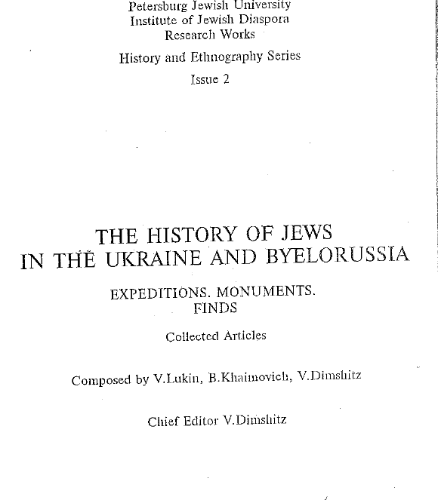

Slide 9
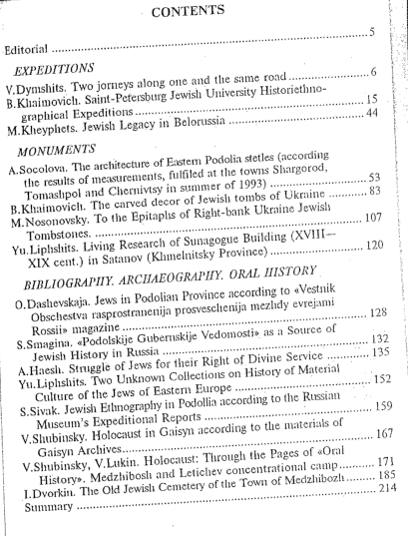

Slide 10
24,000 pages of documents from Kiev:
Kiev province Tax List (Box Tax), 1886-1890
Kiev Jewish Workers, 1899; 1927-1933
Uman district Registry of Foreign Passports, 1891-1892
Uman district Army/Recruits, 1875
Uman district Census, in Zvenigorodka district Census, 1818
Uman district Census, 1818; 1850; 1858; 1859
Kiev district Census, 1811; 1816; 1818; 1834; 1859; 1861-1862
Kiev province Census, 1816; 1818; 1839; 1861
Kiev district Census, 1858
Kiev Kahal/Jewish Community Records , 1834; 1902-1920
Uman Je
Ladyzhinka (Uman district) Census (List of Merchants), 1858wish Workers (List of Merchants), 1858

Slide 11
From Ternopil
Records of incomes and expenditures in the religious society of Shumsk (lists), 1877
Records of donations to the religious society of Shapovolska school in Kremenets (lists), 1882, 17 к.
List of members of religious school in Belozerka, 1895, 9 к.
Census of Kremenets, 1926, 1047 к.
Census of Shumsk, 1927, 102 к.
Records of draftees of 1906, of Kremenets, 1927, 72 к.
Records of the members of the merchants’ Union in Kremenets, 1933, 124 к.
Lists of the voters to Kremenets trade chamber, [1934], 91 к.
Lists of the owners of private businesses in Kremenets district, 1934-35, 90 к.
Lists of craftsmen illegally working in Kremenets, 1936, 29 к.
Lists of the owners of private businesses in Kremenets district , 1936, 16 к.
Records of divorces between Jews in Belozerka, 1880-82, 1885-90, 1896, 1899-1911, 1913-1915, 273 к.

Slide 12
Metrical records for Letichev district, from Khmielnitsky archives
excerpts from the record books of Jews' births and marriages in Letichiv district in 1848.
records of Jews' births, deaths, marriages and divorces in Letichiv in 1841.
records of Jews' births, marriages and deaths in Medzhitozh in 1842.
records of Jews' births, marriages and divorces in Letichiv in 1842.
Records of Jews' births, deaths, marriages, divorces in Letichiv district in 1844
Records of Jews' deaths in Letichiv, Butsnevets and Skitovka in 1847
Records of Jews' births, deaths, marriages and divorces in Letichiv in1847
Records of births (in Russian and Jewish dialects) in Medzhibizh in 1850

Slide 13
Drum roll…new acquisitions from….
From Zhitomir archives
Zhitomir – m 1851-1868
Ivnitsa – m 1858-1863
Leshchin – b 1854-1862
Ianushpol – b 1854-1862
From Ternopil archives
Bereżce – div 1881-1914
Wyszogródek – div 1882-1904, 1914
Katerburg – div 1878-1915
Krzemieniec - b 1874, 1879; div 1889
Łanowce – div 1878-83, 1897-99, 1910
Nowy Oleksiniec – div 1882-1914; d 1896-97, 1899-1906
Poczajów Nowy div 1889-96, 1904-09; d 1878-87, 1890-1911
Szumsk div 1884
From Rivne archives
Kostopol b & d 1934, 1836; b 1930-31; d 1929, 1932; div 1932; m 1961
Stepań m1874, 1887, 1891, 1898; d 1879, 1882-85 , 1894-95; b 1899
Derażne b 1843, 1907; 1847, 1855; d 1864, 1913, 1915; div 1885, 1889

Slide 14
Continuation…
Ludwipol d 1863, 1865, 1877, 1891; m 1863-64, 1891, 1894, 1896; b 1881
Berezno m 1888-1889, 1924-38; d 1888; div 1923-1926; b 1931; b & m 1917-1924
….and much more from Khmelnytski archives – the census records that were previously thought lost in the Kaminetz-Podolsky archive fire

Slide 15
Dr. Janette Silverman
JewishGen Ukraine-SIG Coordinator
ukrainesig.coordinator@gmail.com
http://www.jewishgen.org/Ukraine/default.asp
https://www.facebook.com/pages/Ukraine-SIG/180102942060505

